Slide 1
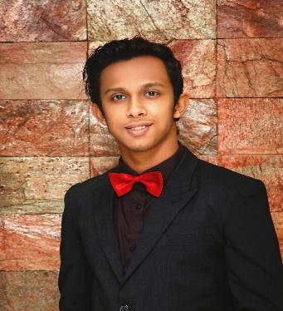






Tanvir
+8801779844251
AHMED
tanahmchw241996@gmail.com
Tanvir Ahmed Chy
CHOWDHURY
PROGRAMMER
COMPUTER SCIENCE AND ENGINEERING
METROPOLITAN UNIVERSITY,SYLHET
EDUCATION
(2016-2019)
HSC
SSC
GPA : 4.50
GPA:5.00
PROG(({201622RAMMER
SCHOLARSHOME
SJISC
(2013-2015)
(2011-2013)
WENT TO PHYSICS,SCIENCE OLYPIAD
HOLD 8TH POSITION(2014)
EXPERIENCE
LANGUAGE
ENGLISH
BANGLA
HTML,CSS
GRAPHIC DESIGN
MICROSOFT OFFICE
SKILLS
JAVA
C++,C
MySQL

